Slide 1
Introduction to Hand Strength and Dexterity
This presentation will help staff by:
Providing more information about this topic.
Showing some additional activities to help support

Slide 2
About Hand Strength
Hand strength is a key feature of successful fine motor work, especially handwriting.
Too much physical effort to create their written work may indeed cause holes in the paper
Too little and we may not be able to read the marks made.

Slide 3
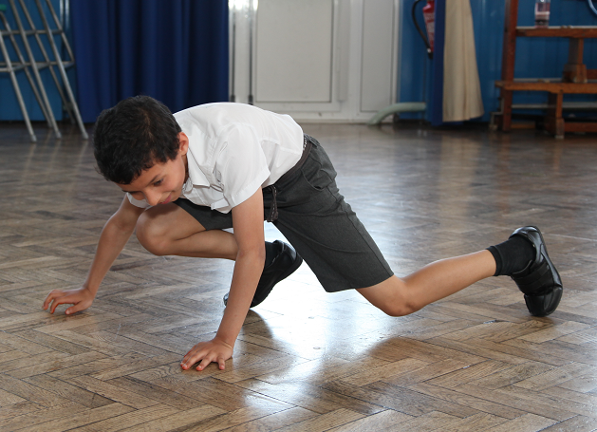
About Hand Strength
Difficulty with core stability, gross motor skills, tone and activity engagement can impact upon hand strength.
As these are all linked, we must remember to work from core stability outwards ensuring that children have the best chance of using their hands effectively to produce written work successfully.

Slide 4
Hand Dexterity and Strength
Hands have many small muscles which are required to be used together to hold and use a pencil.
Dexterity comprises range of movement in the hands and control over these movements. Some children may have difficulty with too much range of movement or too little control.
This causes problems with using their hands for tasks
Good hand strength enables the child to write without their hands cramping or becoming tired.
Good finger strength is needed in combination with this to hold and manipulate the writing instrument.

Slide 5
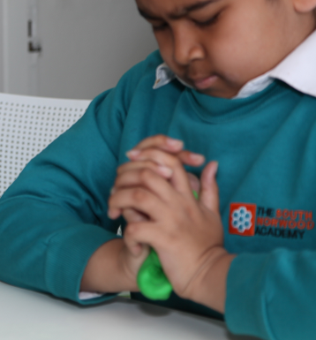
Difficulties with hand strength may be seen in:
Difficulty developing pencil grasp
Pushing too hard or too softly when using a pencil
No strength preventing them from being able to manipulate dough when playing

Slide 6
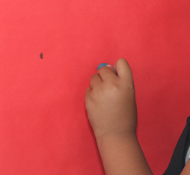
Difficulties with hand strength may be seen in:
Too much wrist flexion when holding a pencil
Use of the shoulder or elbow when completing fine motor activities
Difficulty with daily skills such as opening packets/jars; opening and closing zips for example

Slide 7
Difficulties with hand strength may be seen in:
Hand fatigue
Writing becoming less legible over time
Poor cutlery skills

Slide 8
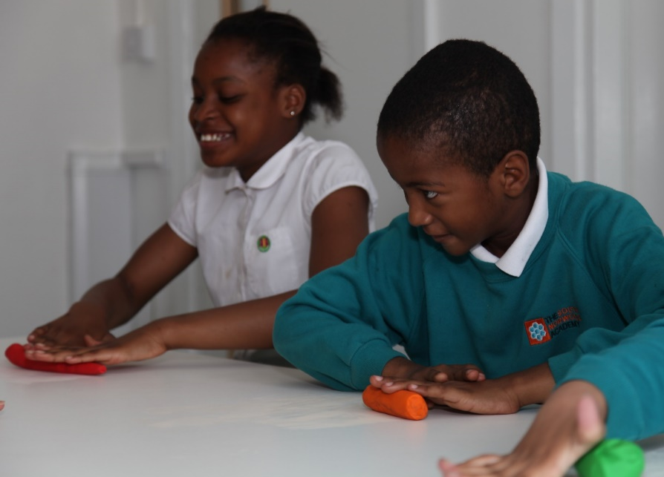
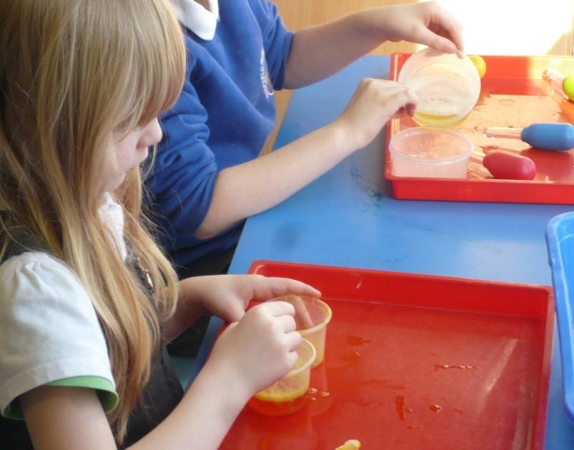
Activities to Support Hand Strength
Using dough or putty – making letter shapes - resistance work with putty will increase hand strength.
Water play – squirty bottles under water, squeezing wet sponges – squeezing will promote strength in flexor muscles in the hands

Slide 9
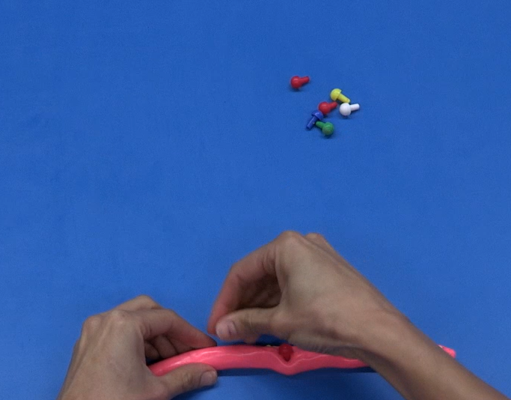
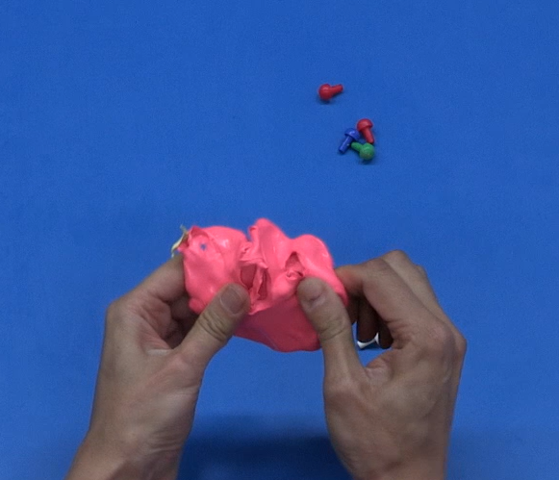
Activities to Support Hand Strength and Dexterity
Roll in ball and make into sausage shape
Put pegs in
Roll again
Use hands to find pegs
(See video in the Handwriting Section for an example of this.)

Slide 10
Activities to support hand strength
Popping bubble wrap – this will promote strength in a pincer grasp required for picking up small objects
Screwing up paper – a fun activity that will increase bilateral hand use and squeezing strength

Slide 11
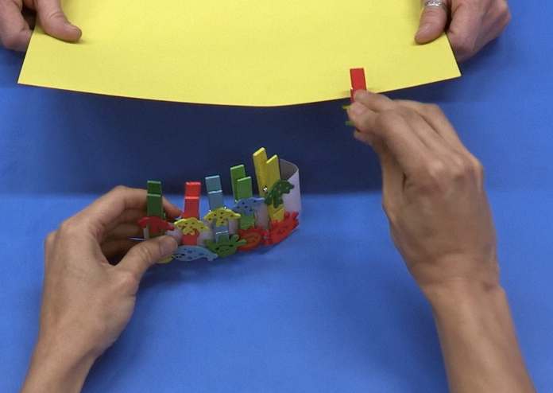
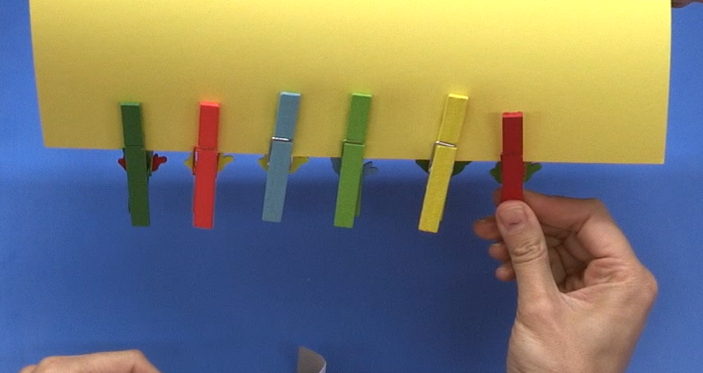
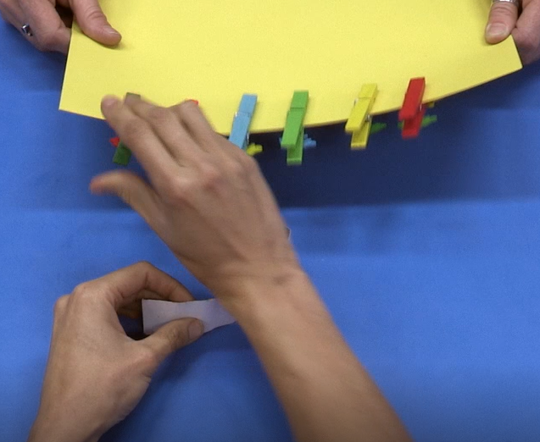
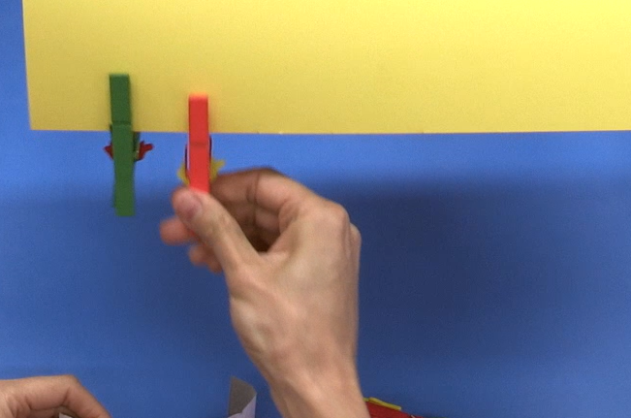
Activities to support hand strength
Clipping pegs to card. (See video)
Take pegs off from a different angle (reach from below)
Different wrist position

Slide 12
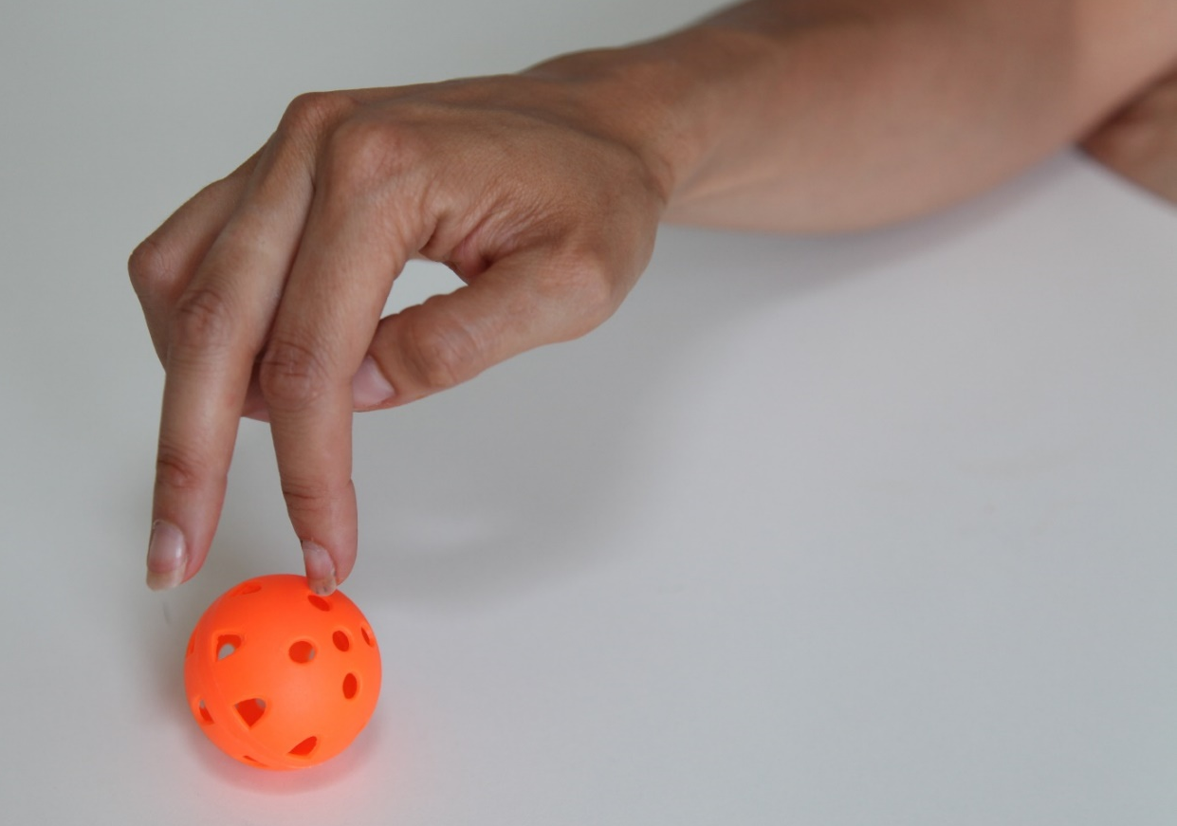
Activities to Support Hand Strength
Walk a ball along the table using fingers – completing this will promote isolated finger movement and use the very small muscles of the hands

Slide 13
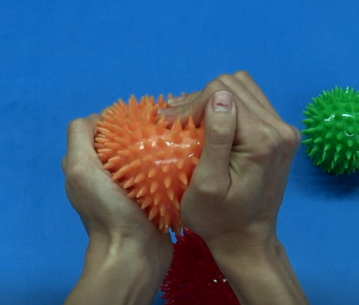
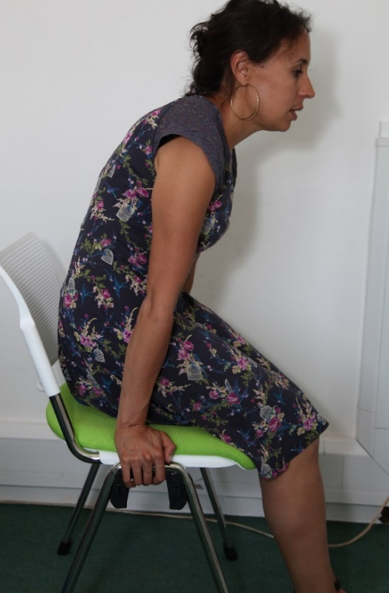
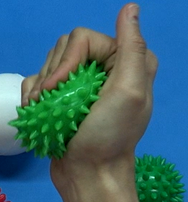
Activities to Support Hand Strength
Chair push ups – this increases shoulder and upper limb stability
Use textured balls to promote hand strength

Slide 14
Activities to support hand strength
Hand squeezes

Slide 15
Activities to support hand strength
Work at an easel to increase wrist extension
Increasing wrist extension promote a tripod grasp required for holding a pen

